Slide 1
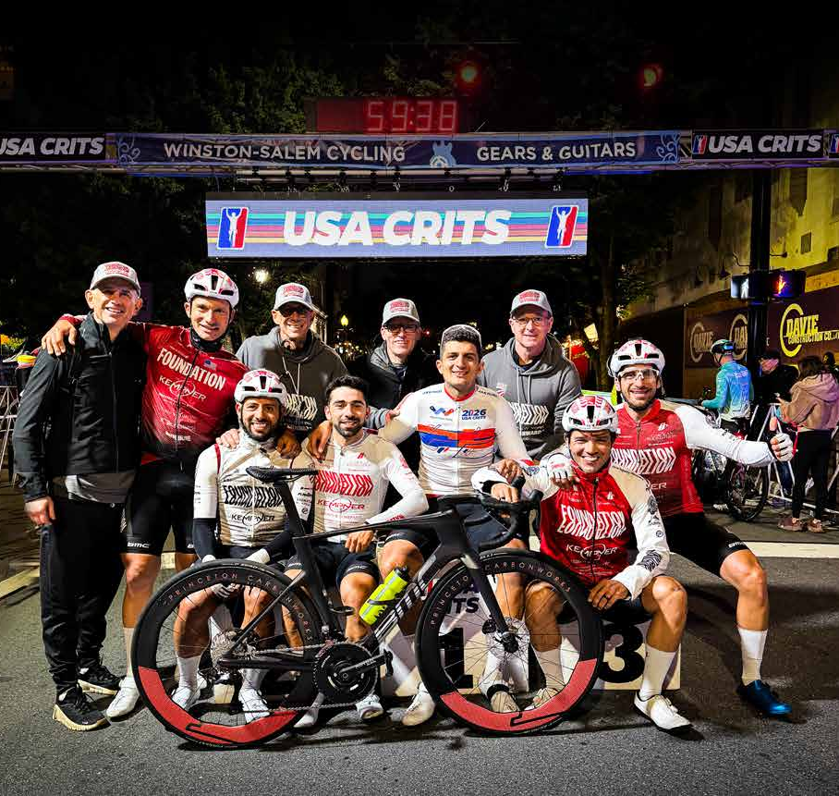
FOUNDATION CYCLING NEW YORK
Race with
a purpose
2027 partnership opportunities
01
Notes:
Source: supplied Promotional Deck_2027_e(1).pdf, original page(s) 1. Team-reported information, not independently audited. Photos extracted from that supplied deck.

Slide 2

FOUNDATION CYCLING NEW YORK
A New York institution since 2000
Elite racing. Rider development.
A commitment to giving back.
Foundation creates opportunities for cyclists across New York and beyond, combining a competitive race program with community involvement.
501(c)(3) charitable organization
02
Notes:
Source: supplied Promotional Deck_2027_e(1).pdf, original page(s) 2. Team-reported information, not independently audited. Photos extracted from that supplied deck.

Slide 3
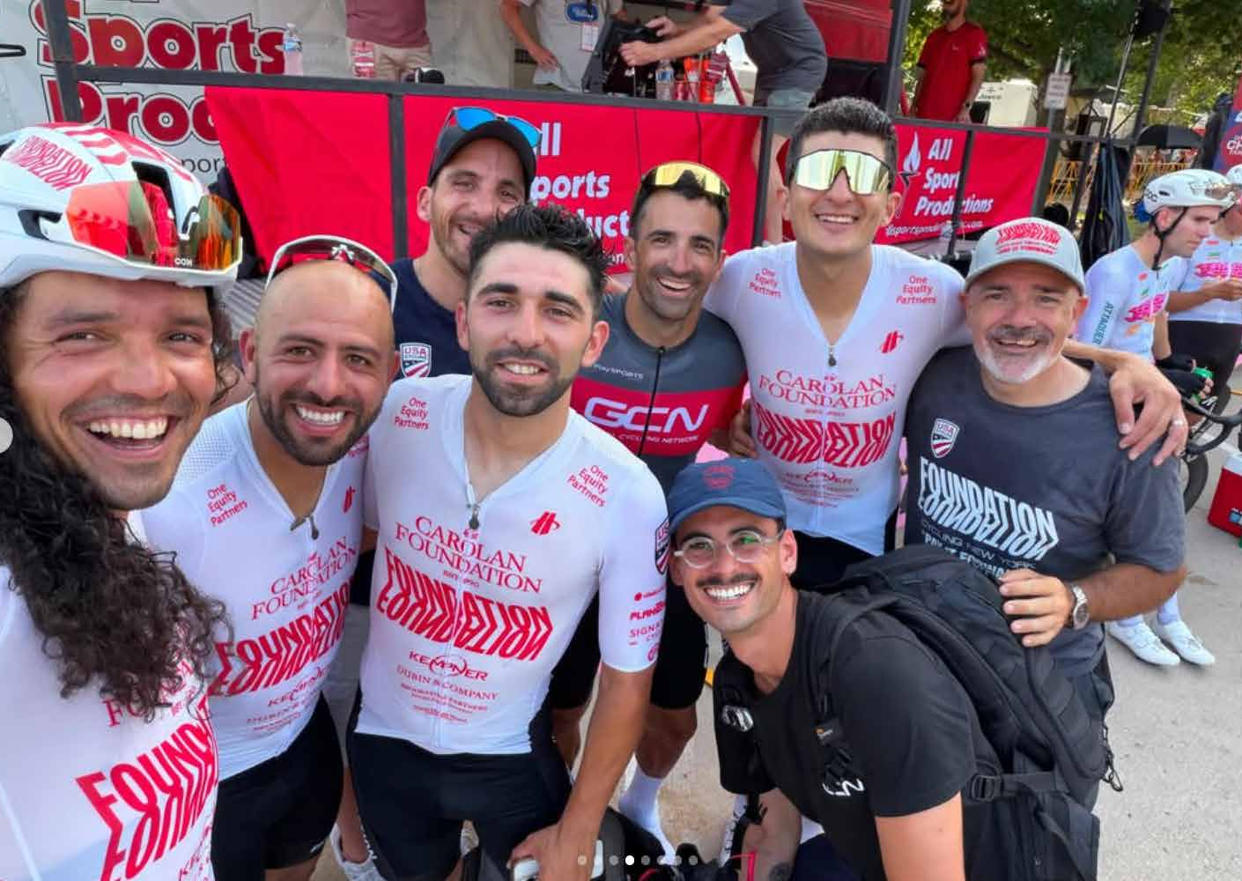
FOUNDATION CYCLING NEW YORK
A club with room to grow
160+
club members, ages 16–85
Professional criterium racing
Youth development
Local women’s and men’s racing
U23 women through CCB support
Gravel, time trial, triathlon and Zwift
Charity rides and training rides
03
Notes:
Source: supplied Promotional Deck_2027_e(1).pdf, original page(s) 2, 4. Team-reported information, not independently audited. Photos extracted from that supplied deck.

Slide 4
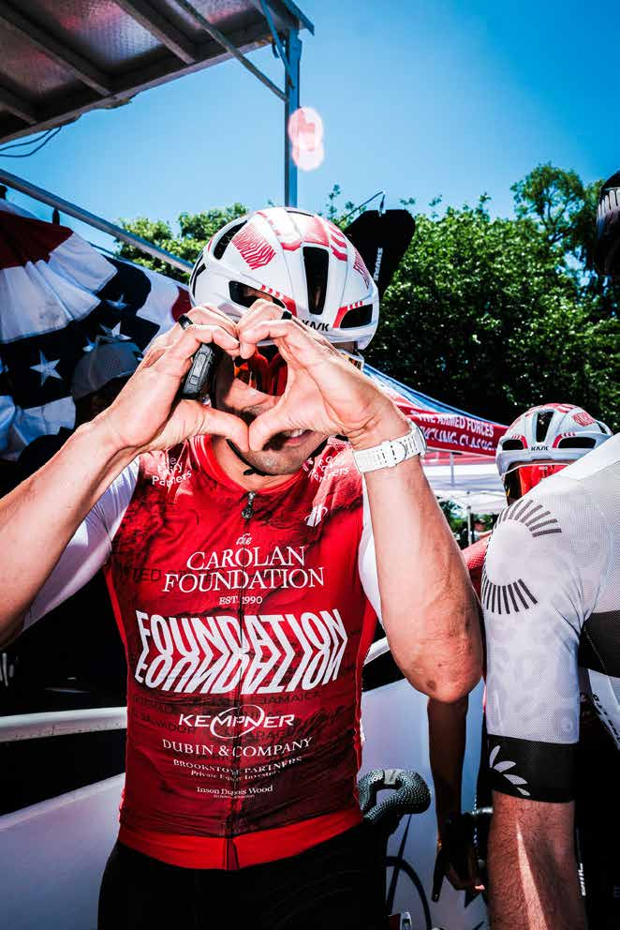
FOUNDATION CYCLING NEW YORK
The mission
Access
Help diverse cyclists reach the resources and opportunities they need to progress.
Development
Create a pathway toward professional racing and national team opportunities.
Community
Use cycling to support charitable causes.
04
Notes:
Source: supplied Promotional Deck_2027_e(1).pdf, original page(s) 5. Team-reported information, not independently audited. Photos extracted from that supplied deck.

Slide 5
FOUNDATION CYCLING NEW YORK
A record of charitable support
$1.85M+
Beneficiary | Reported support
Star Track | $500,000
CaringKind | $600,000+
Best Buddies | $500,000
Cycle for Survival | $250,000
raised for charitable causes
Additional support includes Mt. Sinai ICU, CRCA, Harlem Academy, Maccabi USA and the Central Park Conservancy.
Cumulative totals reported by Foundation in its source deck. Time period and accounting basis are unspecified.
05
Notes:
Source: supplied Promotional Deck_2027_e(1).pdf, original page(s) 6. Team-reported information, not independently audited. Photos extracted from that supplied deck.

Slide 6
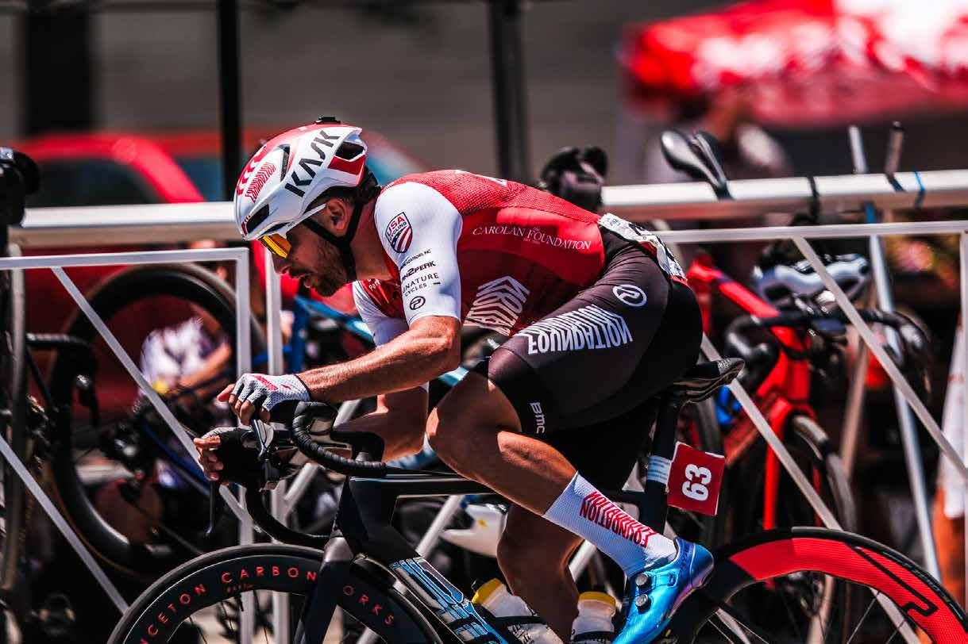
FOUNDATION CYCLING NEW YORK
A pathway to higher levels
30
racers advanced to the professional ranks
15
additional riders advanced to national teams
Foundation reports that 85%+ of its listed alumni and national team riders come from multicultural backgrounds.
06
Notes:
Source: supplied Promotional Deck_2027_e(1).pdf, original page(s) 7. Team-reported information, not independently audited. Photos extracted from that supplied deck.

Slide 7
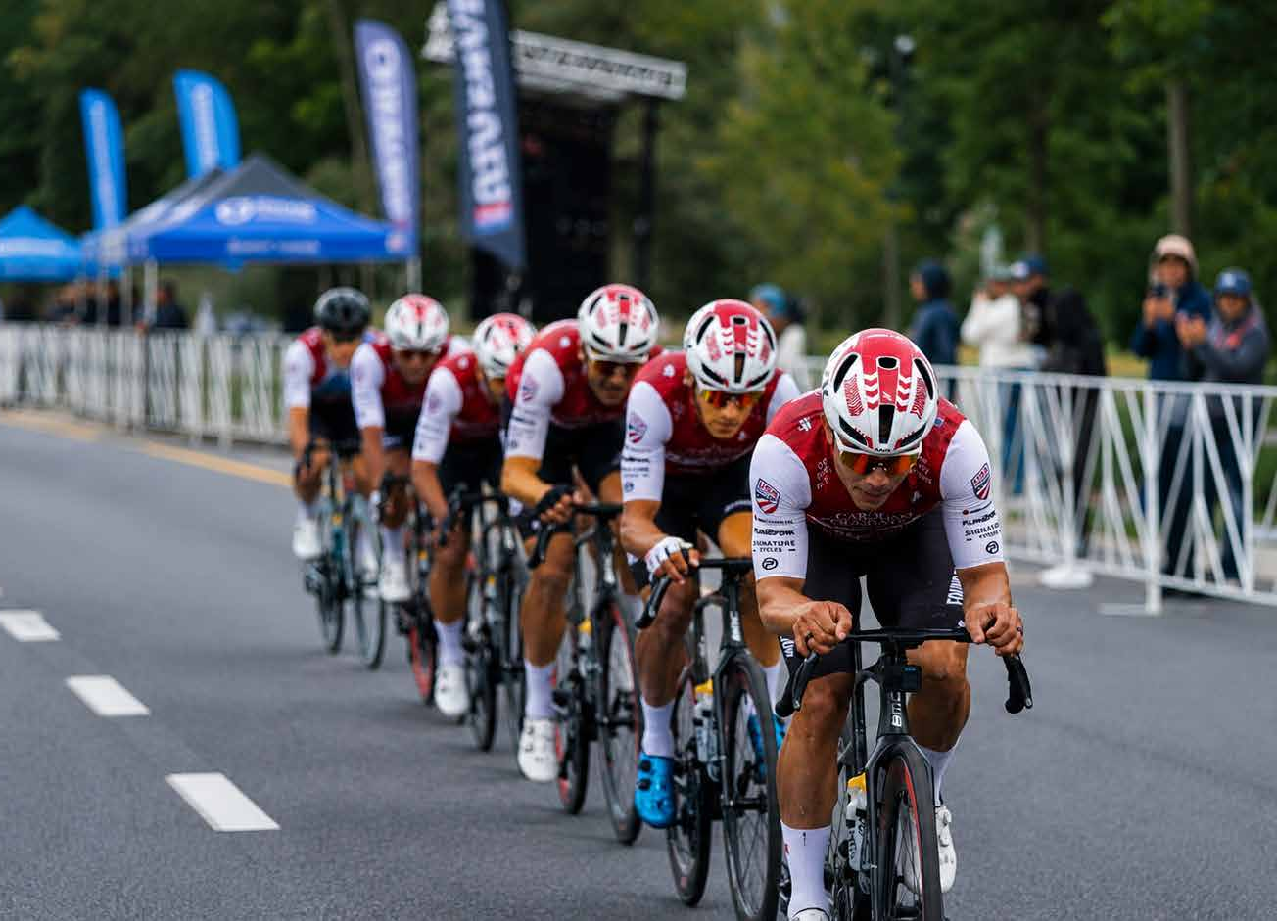
FOUNDATION CYCLING NEW YORK
A competitive racing platform
#1
USA CRITS Pro Men D1 Team
6,739
2026 championship team points
USA CRITS 2026 final standings. Source: usacrits.com
07
Notes:
Source: supplied Promotional Deck_2027_e(1).pdf, original page(s) 13–14. Team-reported information, not independently audited. Photos extracted from that supplied deck. Verified against USA CRITS 2026 final standings at https://usacrits.com.

Slide 8
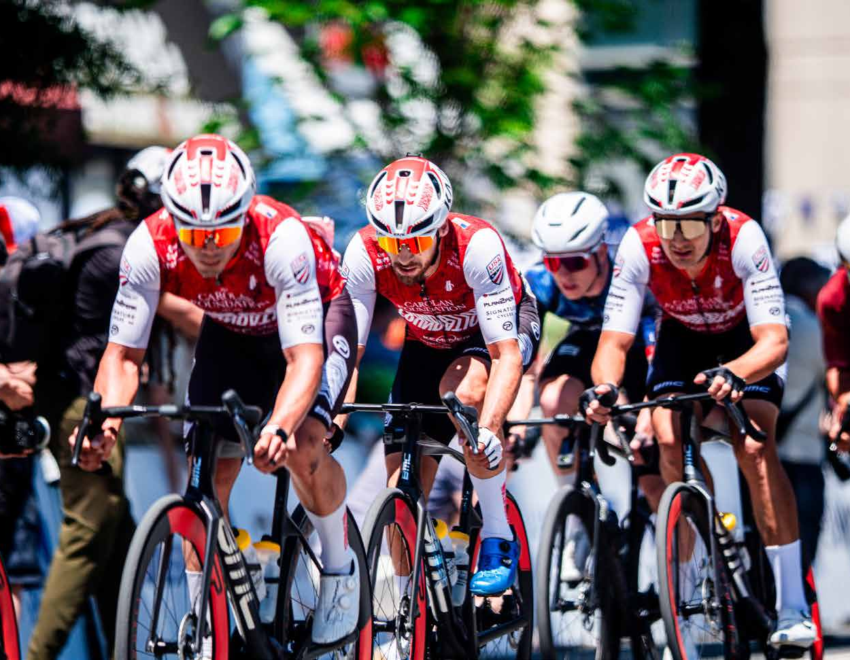
FOUNDATION CYCLING NEW YORK
The 2027 race platform
International
Opportunities for riders with Caribbean and Latin American ties.
National
Premier U.S. criterium and road events.
Regional
A strong presence in New York City and the Northeast.
Program direction from the source deck. A confirmed 2027 race calendar will form part of the partnership agreement.
08
Notes:
Source: supplied Promotional Deck_2027_e(1).pdf, original page(s) 15–16. Team-reported information, not independently audited. Photos extracted from that supplied deck.

Slide 9
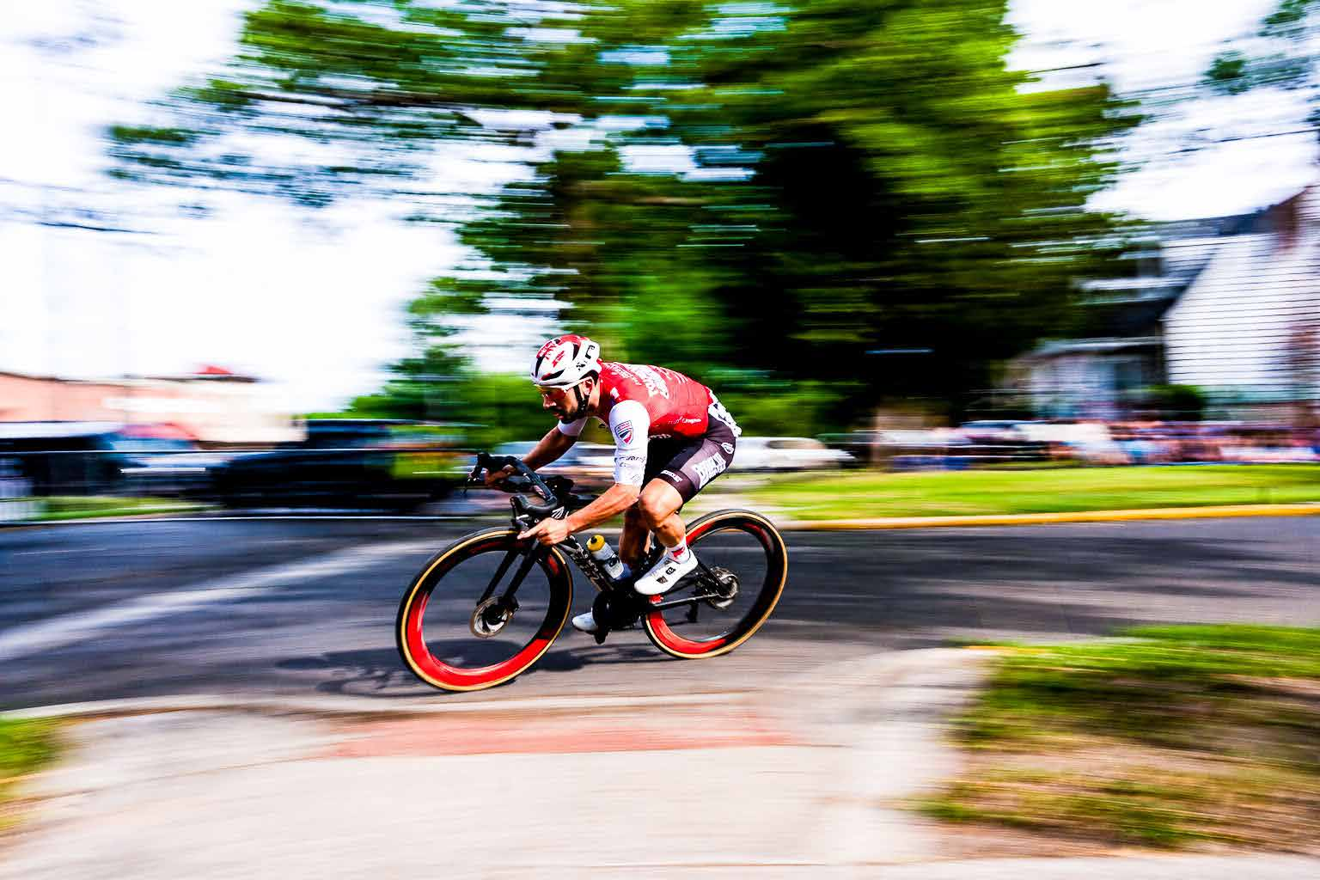
FOUNDATION CYCLING NEW YORK
Brand visibility in the race and beyond
Apparel
Brand placement on the team’s jersey, skinsuit and other agreed apparel.
Race presence
Event visibility, sampling and hospitality opportunities matched to the partner’s goals.
09
Notes:
Source: supplied Promotional Deck_2027_e(1).pdf, original page(s) 8–9. Team-reported information, not independently audited. Photos extracted from that supplied deck.

Slide 10
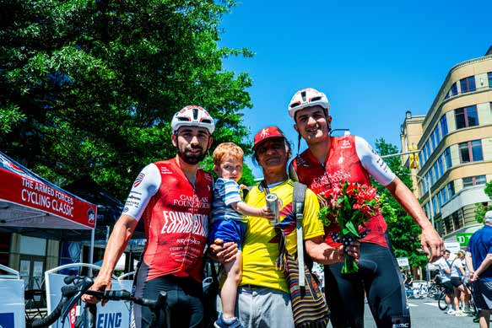
FOUNDATION CYCLING NEW YORK
Stories people can connect with
Rider journeys and race coverage create a natural setting for product integration and partner storytelling.
Social posts, reels and stories
Product use and rider reviews
Community and charity activations
The source deck reports 2.2 million Instagram views. Measurement period and methodology are unspecified.
10
Notes:
Source: supplied Promotional Deck_2027_e(1).pdf, original page(s) 2, 8–9. Team-reported information, not independently audited. Photos extracted from that supplied deck.

Slide 11
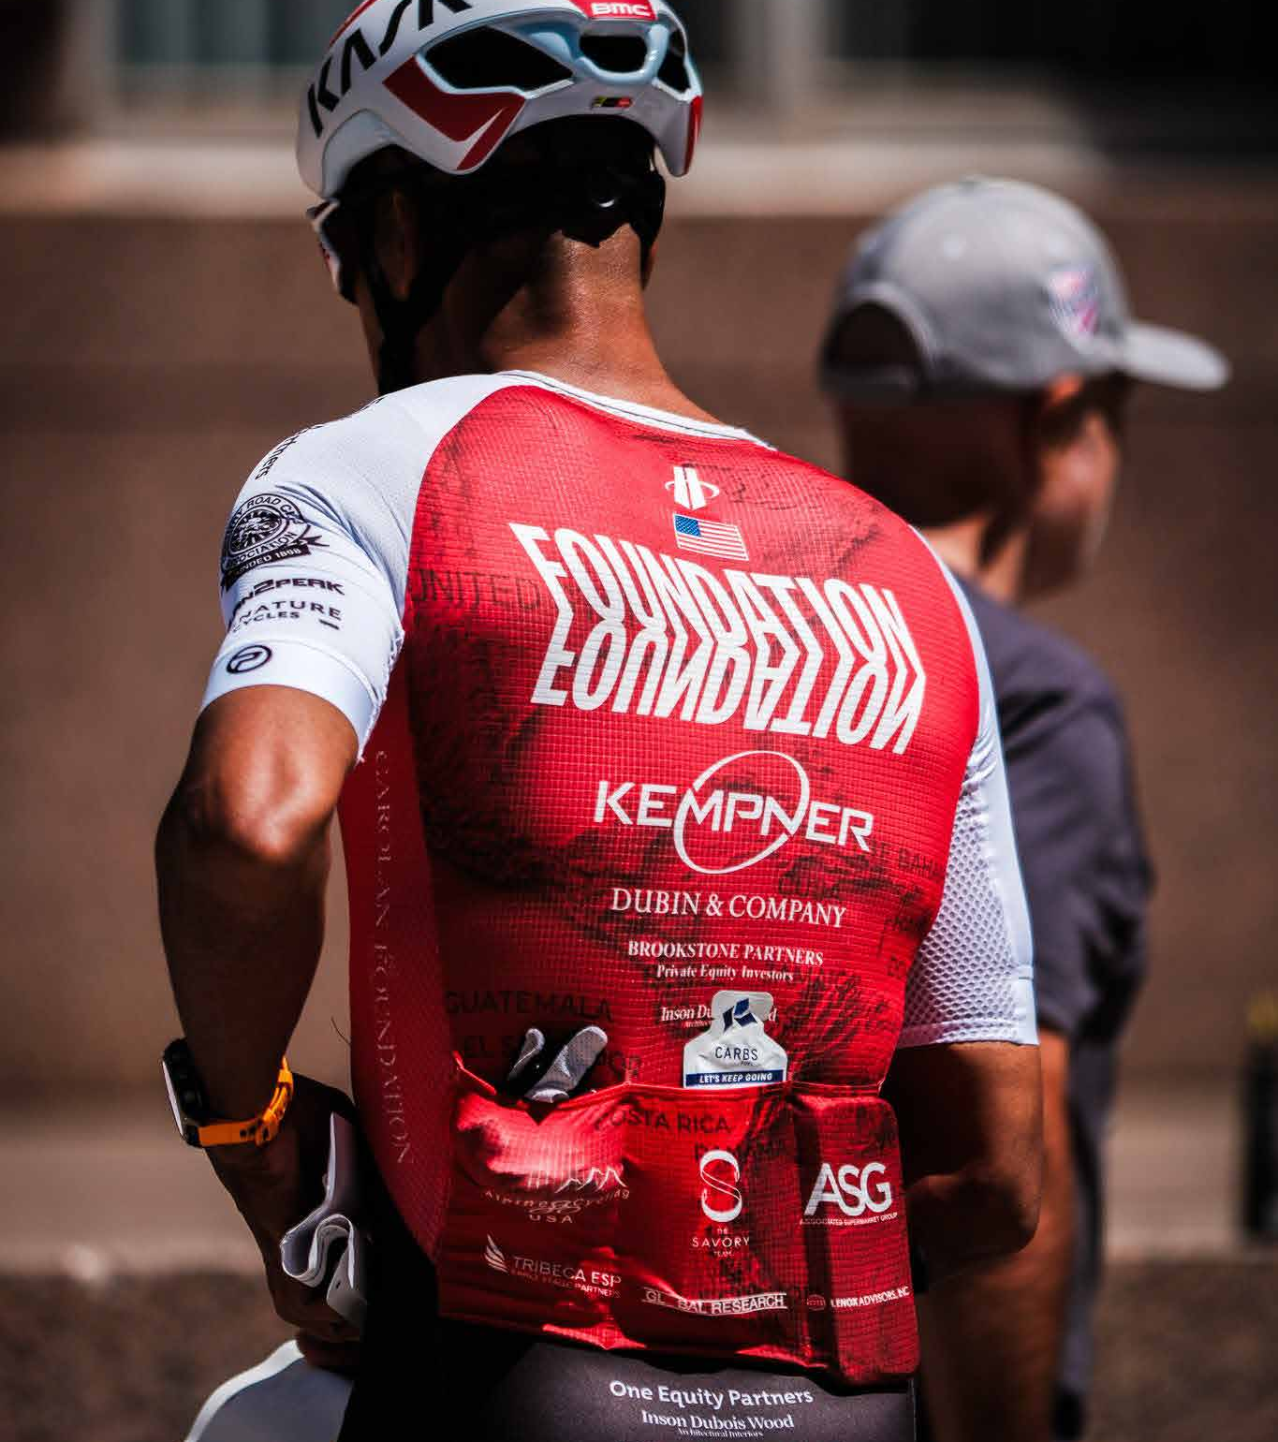
FOUNDATION CYCLING NEW YORK
A partnership with reciprocal value
$650K+
invested in supporting brands
Foundation reports purchasing products from the companies that support its team. Riders provide a real setting for equipment use and product stories.
Cumulative spending reported by Foundation. Time period and accounting basis are unspecified.
11
Notes:
Source: supplied Promotional Deck_2027_e(1).pdf, original page(s) 10. Team-reported information, not independently audited. Photos extracted from that supplied deck.

Slide 12
FOUNDATION CYCLING NEW YORK
2027 partnership packages
Level | Investment | Core placement / opportunity
Title | $200,000 | Premier apparel, digital, events and custom activation
Platinum | $50,000–$75,000 | High visibility apparel, digital and content integration
Gold | $25,000–$50,000 | Sponsor logo below the team logo
Silver | $10,000–$25,000 | Sponsor logo on sleeves
Bronze | $5,000–$10,000 | Sponsor logo on back pocket
Pricing and core placements reproduce the supplied deck. Final scope, term and availability require a written agreement.
12
Notes:
Source: supplied Promotional Deck_2027_e(1).pdf, original page(s) 11. Team-reported information, not independently audited. Photos extracted from that supplied deck.

Slide 13
FOUNDATION CYCLING NEW YORK
A clear scope for every partner
Before the season
During the season
After activation
Agree the package, apparel placement, content scope, event opportunities and reporting cadence.
Coordinate product use, race coverage and community activations around the agreed calendar.
Review delivery with a recap of agreed media, engagement and event metrics.
Proposed delivery framework. Quantities, dates and success measures will be set together in the partnership agreement.
13
Notes:
Source: supplied Promotional Deck_2027_e(1).pdf, original page(s) 8–9. Team-reported information, not independently audited. Photos extracted from that supplied deck. This slide proposes a clearer partnership workflow, not a statement of existing commitments.

Slide 14
FOUNDATION CYCLING NEW YORK
Partners and supporters
The Carolan Foundation
Kempner
One Equity Partners
Brookstone Partners
Dubin & Company
Princeton CarbonWorks
BMC
Hincapie Sportswear
The Feed
Plan2Peak
Lenox Advisors
The Willens Report
The Savory Group
Global Research
Kask and Koo
A history of relationships across cycling, business and philanthropy.
Selected organizations named in the source deck. Participation and rights for 2027 remain subject to confirmation.
14
Notes:
Source: supplied Promotional Deck_2027_e(1).pdf, original page(s) 12. Team-reported information, not independently audited. Photos extracted from that supplied deck.

Slide 15
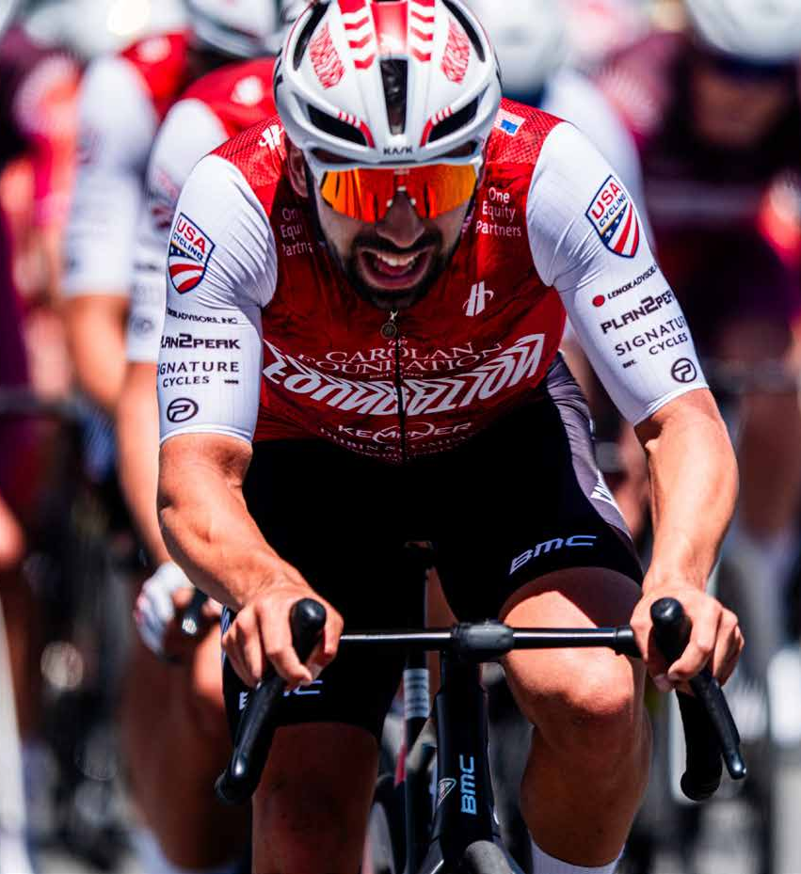
FOUNDATION CYCLING NEW YORK
The next season
starts with a
conversation
A partnership can support racing ambition while creating opportunities for more riders.
15
Notes:
Source: supplied Promotional Deck_2027_e(1).pdf, original page(s) 5, 8. Team-reported information, not independently audited. Photos extracted from that supplied deck.

Slide 16
FOUNDATION CYCLING NEW YORK
2027 partnership enquiries
Richard “Ric” Wolf
ric@globalresearchnet.com
(917) 833-3376
foundationcyclingnewyork.org
16
Notes:
Contact details verified by parent agent on the current official Foundation Cycling New York website, https://www.foundationcyclingnewyork.org. Contact differs from the older AOL email in the supplied deck.

